Slide 1
Parallel Machine Simulator
STJEPAN ANTIVO IVICA

Slide 2
RAM (Random Access Machine)
unbounded number of local memory cells
operations for moving data between memory cells; comparisons and conditional branches; and simple arithmetic operations
program starts with the first instruction and ends when a HALT instruction
all operations take unit time regardless of the lengths of operands
time complexity is equal to the number of instructions executed
space complexity is equal to the number of memory cells accessed

Slide 3
Abstract computer for designing parallel algorithms
PRAM is straightforward and natural generalization of RAM
unbounded collection of numbered RAM processors P₀, P₁, P₂,...
unbounded collection of shared memory cells M[0], M[1], M[2],...
each P_{i} has its own (unbounded) local memory and knows its index I
each processor can access any shared memory cell
P0 has a special activation register specifying the maximum index of an active processor
Initially, only P0 is active, it computes the number of required active processors and loads this register. Then the other corresponding processors start executing their programs. Computation proceeds until P0 halts

Slide 4
PRAM (Parallel Random Access Machine)
PRAM is used by parallel – algorithm designers to model parallel algorithmic performance
PRAM corresponds intuitively to the programmers' view of a parallel computer
Handling shared memory access conflicts
CRCW, CREW, ERCW, EREW
All – prefix – sums (scan operation)
implementation of scan operation
Reduce

Slide 5
Interpreter
tool that interprets code written for PRAM computer and simulate its behavior
focus on functionality not performance
Two approaches (1. interpreter; 2. pre – interpreter)
second approach: pre – interpreter on top of the Python interpreter
Python – like syntax
PMS (Parallel Machine Simulator)

Slide 6
Interpreter language
block oriented
prefix unfinished block with “… ” and prefix start of block with “>>> ”
forbidden usage of tabs
pre – interpreter statements: Comment, Load, PRAM, Reset and Verbose
interpreter statements: depending on a memory model
if RAM memory model all Python statements
If any PRAM model: Assignment, For, If, Parallel, Pass, Print and While
no function can be called within parallel block
scan and reduce for all models

Slide 7
Pre – interpreter statements
# this is a comment
:load <file>
:pram <MODEL>, MODEL ϵ {CRCW, CREW, ERCW, EREW}
:reset
:verbose <Boolean>

Slide 8
Interpreter statement
<lhs> = <rhs> // +=, -=, *=, /=, //=, %=, **=, >>=, <<=, &=, ^=, |=
for <it> in <range>:
#statement(s)
if ( <condition> ):
#statement(s)
parallel <inpv> in <al>:
#statement(s)
pass
print <rhs>
while (<conditional>):
#statement(s)

Slide 9
Scan & Reduce
scan(function, iterable[, state])
scan(operator.add, [1,2,3]) returns [1, 1+2, 1+2+3]
reduce(function, iterable[, initializer])
reduce(lambda x, y: x+y, [1, 2, 3, 4, 5]) calculates ((((1+2)+3)+4)+5)

Slide 10
Architecture
Java 8, Maven, Spring Context Framework, Jython
Parallel Machine Simulator
Interpreter
Pre – interpreter
Model
Output
Exception
PRAM Processor
Memory

Slide 11
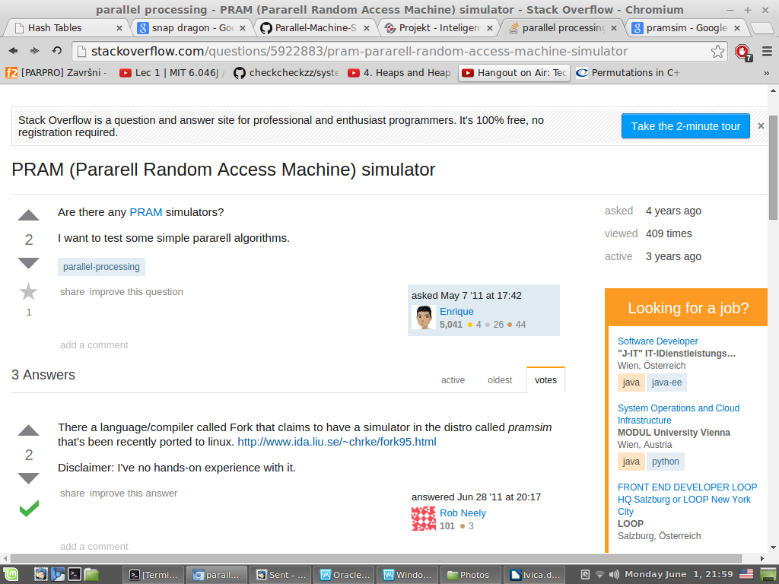
Other solutions and comparisons

Slide 12
Fork
although criticized for being unrealistic, a PRAM has actually been realized in hardware in the 1990s by the SB-PRAM project of Wolfgang Paul's group at the University of Saarbrücken – a physical realization of a CRCW PRAM
Fork is a programming language for the PRAM model; it has been implemented for the SB-PRAM
Fork offers full expressibility for many known parallel algorithmic paradigms
Fork is based on ANSI C

Slide 13
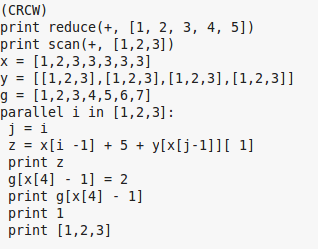
Demo 1 – Try it out

Slide 14
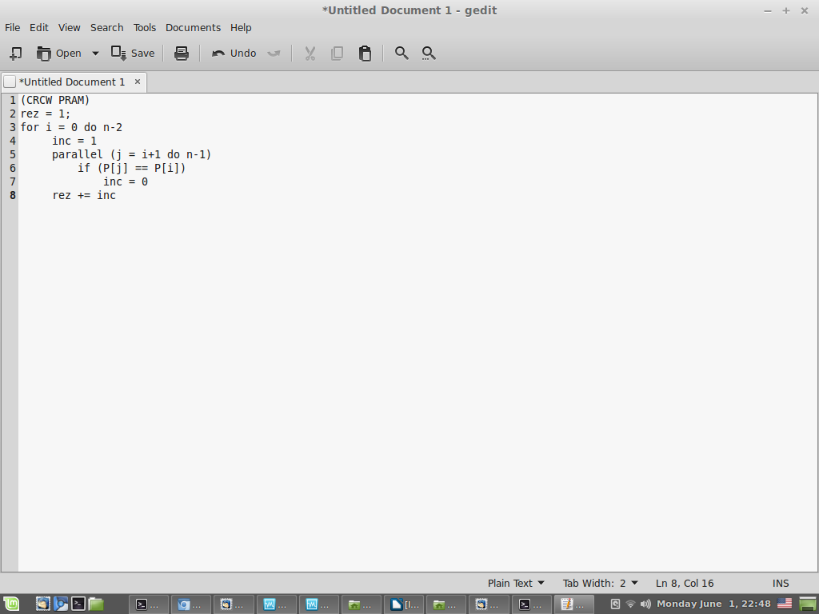
Demo 2 – Simple CRCW Solution
CRCW
for given array P[]
determine number of
different elements
For example:
input: [1, 2, 1, 3, 4, 2, 5, 1]
output: 5

Slide 15
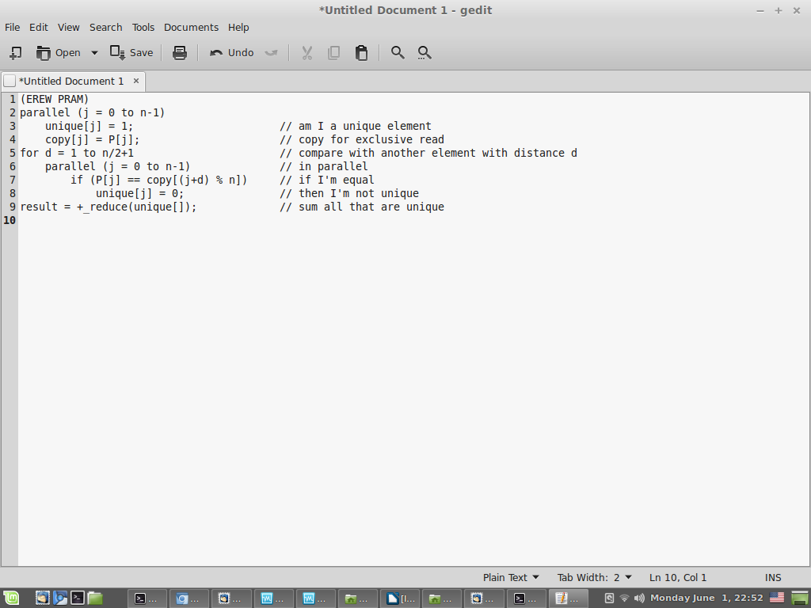
Demo 3 – Shared memory constraints
Same assignment but EREW. Proposed solution:
Does it work ?

Slide 16
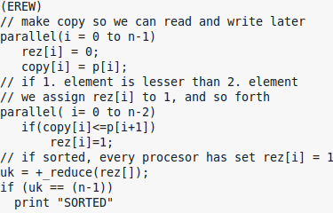
Demo 4 – Shared memory constraints 2
EREW. Given array A,
is A sorted ?

Slide 17
Conclusion
multithreaded chip multiprocessors are becoming more and more mainstream architecture
simple parallel programming model (and the PRAM is the simplest one) could be a realistic option for a future general-purpose programming model
we believe that PMS will prove to be useful tool in designing algorithms for PRAM.
no similar open source solutions

